Slide 1
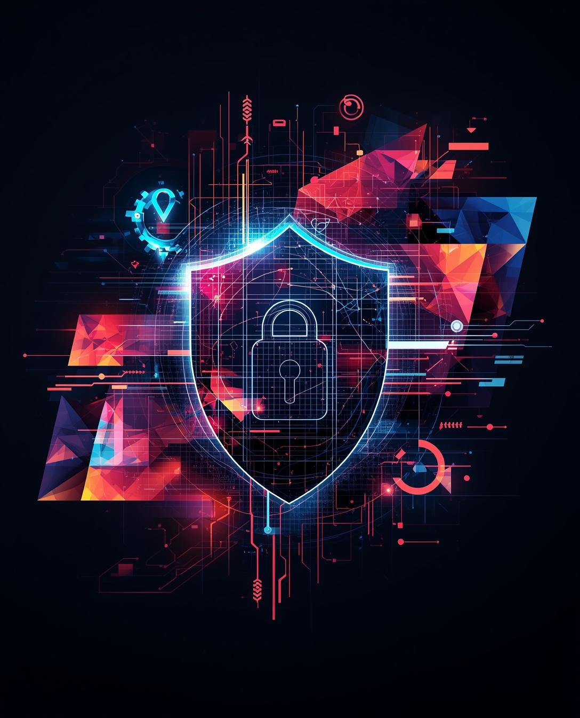

CYBER SECURITY
Basics and Threats
PRESENTED BY SANGMESH PATIL

Slide 2


Introduction to Cyber Security
Protecting Systems, Networks, and Data
Cyber security involves safeguarding computer systems and networks from unauthorized access and attacks, ensuring the integrity and privacy of sensitive digital information in our daily lives.

Slide 3
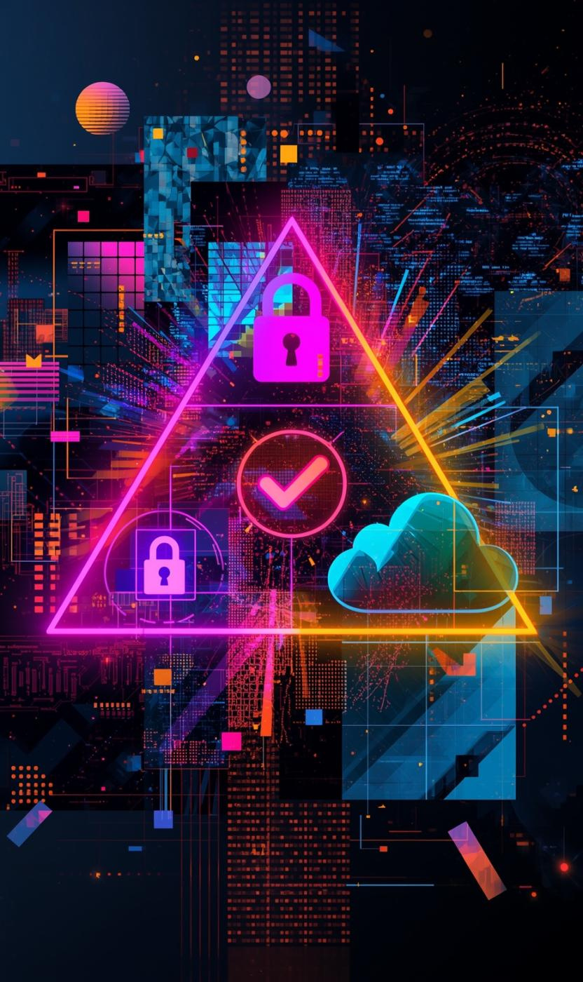
CIA Triad Overview
Core Principles of Cyber Security
Confidentiality: Protect sensitive data
Integrity: Ensure accurate data
Availability: Guarantee access to systems

Slide 4
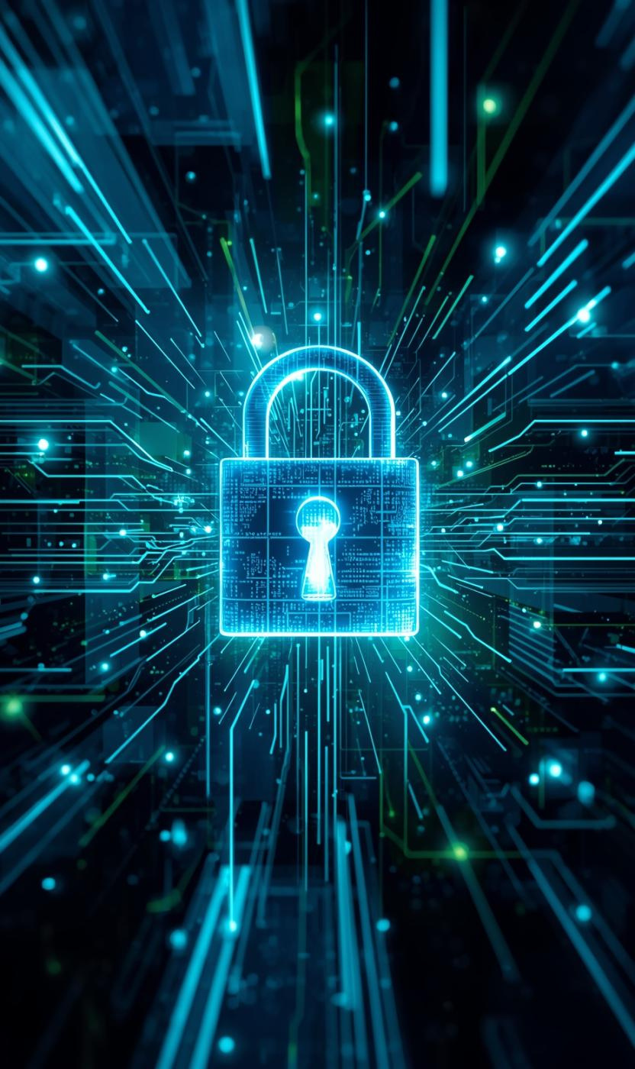
Confidentiality Explained
Safeguarding privacy through data protection
Protecting sensitive data from unauthorized access is crucial for maintaining trust and ensuring privacy in digital interactions.

Slide 5

Integrity and Availability
Ensuring accurate data and system access
Maintaining data accuracy and timely access are crucial for effective cyber security management and organizational success.

Slide 6

Types of Cyber Threats
Overview of common cyber threats
Malware: harmful software like ransomware
Phishing: deceptive emails for information
DoS/DDoS attacks: server overload tactics
Man-in-the-Middle: communication interception
Password attacks: credential guessing techniques

Slide 7

Malware & Phishing
Illustrating digital threats and risks
This visual representation highlights the dangers of malware and phishing, emphasizing the need for vigilance in cyber security.

Slide 8

Network Attacks
Illustrating server overload and communication interception
This visual representation captures the impact of DoS/DDoS attacks and highlights the risk of Man-in-the-Middle attacks.

Slide 9
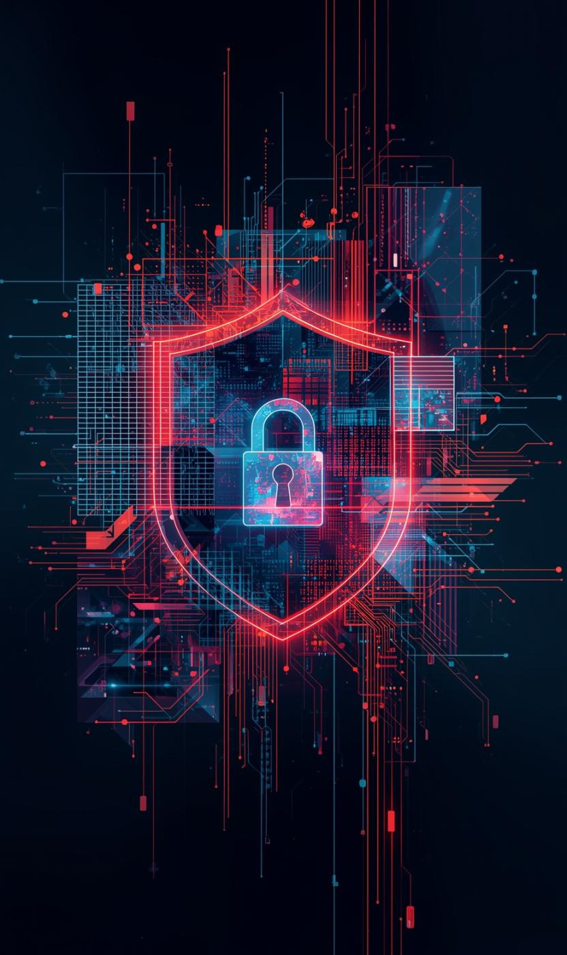
Importance of Cyber Security
Why Cyber Security Matters Today
Protects personal information and privacy
Prevents financial losses and theft
Ensures business continuity and stability
Safeguards national infrastructure assets
Builds trust between organizations and users

Slide 10
Conclusion
The Importance of Cyber Security
Cyber security is vital for protecting the digital world. Understanding threats and applying security measures can significantly reduce risks and ensure a safer online experience for everyone.

